Slide 1

MARKET SEGMENTATION PROJECT
Build the Lineup
One market. Three kinds of customers. Three versions of your product.
Notes:
Today we take everything from the last two projects and flip it. Instead of being handed the segments, you find them, and instead of one product, you build three.

Slide 2


Where We've Been
Target Marketing
Million Dollar Media Buy
Build the Lineup
You read survey data and found who buys.
You spent money reaching segments we gave you.
You find the segments and build a product for each one.
STEP 1
STEP 2
TODAY
Notes:
Quick recap. Ask: in Media Buy, who decided what the segments were? (We did.) Today that's your job.

Slide 3
Why does one product come in three versions?
Think of something you've bought that had a basic, a middle, and a premium option.
Notes:
Turn and talk, 60 seconds. Collect examples: phone storage sizes, streaming plans, car trims, meal sizes, concert tickets, sports camp packages.

Slide 4



Good, Better, Best Is Everywhere
Streaming
Phones
Cars
With ads
Base storage
Base trim
No ads
More storage
Sport trim
4K + extra screens
Pro camera
Luxury trim
Notes:
Same company, same core product. Each version is built for a different group of customers, and each one has a different price.

Slide 5
Market Segmentation
Dividing a whole market into smaller groups of customers who share the same needs, wants, or buying habits.
You already know the lenses: demographic, geographic, psychographic, behavioral, socioeconomic. Segmentation uses them to split the market.
Notes:
Connect to target marketing: the lenses are how you describe a segment. Segmentation is splitting the whole market into those groups before you pick who to serve.

Slide 6




What Makes a Good Segment?
Similar inside
Different outside
Big enough
Reachable
People in it want the same things.
It wants different things than other segments.
Enough customers to be worth a version.
You can actually get your message to them.
Notes:
Media Buy callback: Reachable is why the media channels mattered. A segment you can't reach is a segment you can't sell to.

Slide 7
Every Feature Costs Money
Unit cost
Base cost + every feature you add
Maya's Collector package: $5 + $3 + $6 + $12 + $2 = $28 a pair before she charges a cent.
Notes:
Every feature makes the product better for someone and more expensive for the company. The question is never 'is this feature good?' It's 'does THIS segment care enough to pay for it?'

Slide 8
Must-Have, Nice-to-Have, or Don't Care?
0%
30%
60%
100%
Don't care
Nice-to-have
Must-have
Under 30%
30% to 59%
60% or more
Adds cost, nothing else
+5% Fit for each one
Leave it out: buyers cut in half
The survey asked each segment: “Would you only buy it if it had this?”
Notes:
These cutoffs come from the survey in your case file. Must-haves are deal-breakers: a version missing one loses half its buyers.

Slide 9
Higher Price, Fewer Buyers
Willingness to pay
Every segment has a price where people start walking away.
Which of Maya's segments could she charge the most? Which one bails first?
Notes:
Collectors barely drop until $80. Weekend Wearers fall off a cliff after $30. Same service, totally different price tolerance.

Slide 10
How You Score a Version
1. Unit cost
2. Fit
3. Buyers
4. Profit
Base cost + features
100%, +5% per nice-to-have, ÷2 per missing must-have
Size × % who'd buy × Fit
Buyers × (Price − Unit cost)
Prices come from your case file's price list. Test at least two for every version.
Notes:
These four steps are on your case file and in your guide. Walk through them once now, then we'll do Maya's numbers together.

Slide 11
WORKED EXAMPLE
Maya's Sneaker Restoration
Weekend Wearers
Collectors
Team Athletes
600 potential customers
150 potential customers
300 potential customers
“I just want them to look clean for homecoming.”
“A crease costs me $50 on resale.”
“I need them back by Friday's game.”
Notes:
Maya is back. She restores sneakers and wants three packages instead of pricing every job by hand. Read the quotes. What does each group care about?

Slide 12
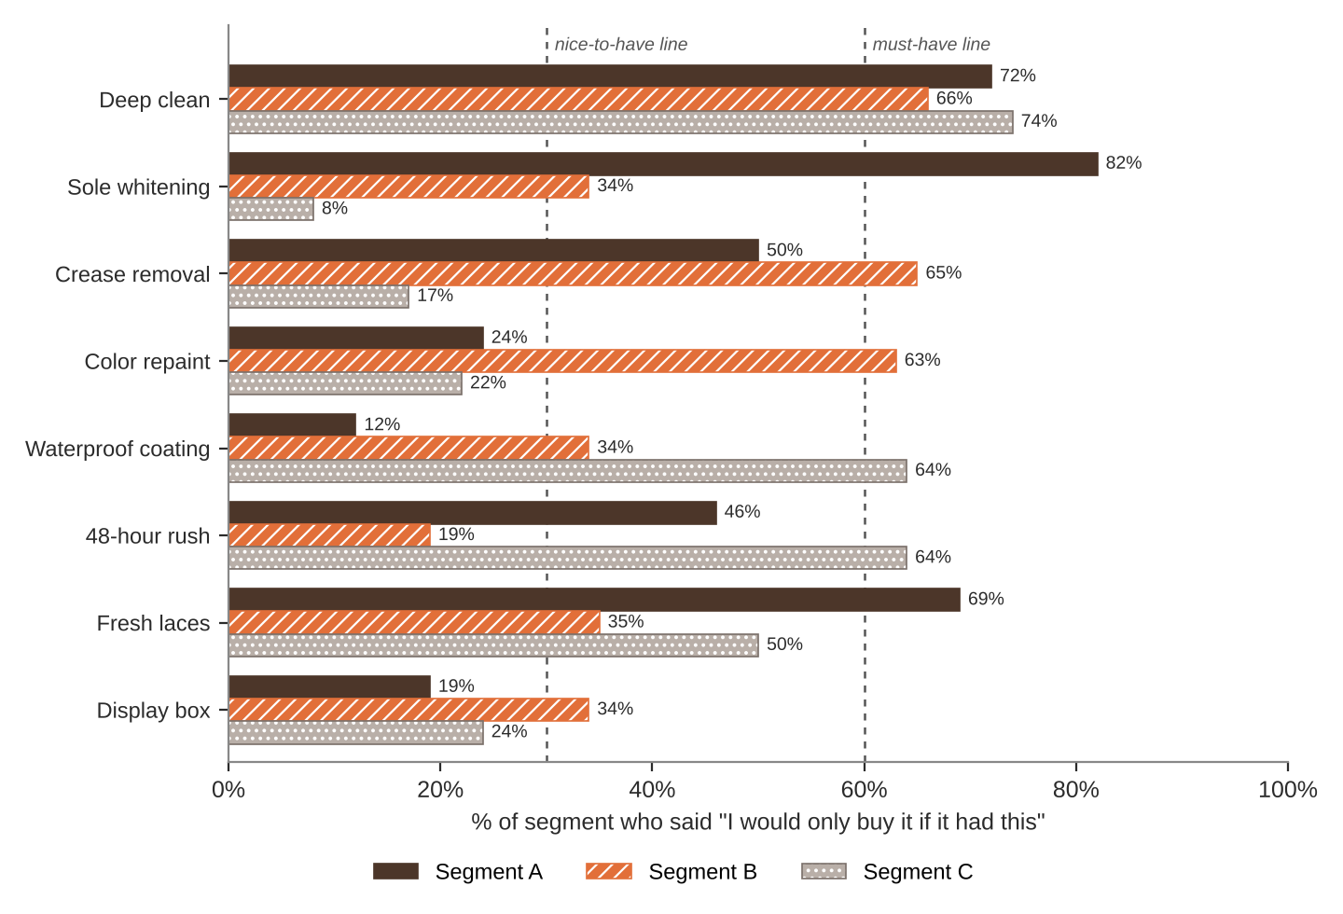
What Does Each Segment Require?
Read it like a scout
Which features cross the must-have line for Collectors?
Which feature does nobody require?
Notes:
Collectors' must-haves: Deep clean, Crease removal, Color repaint. Nobody requires the display box (top value 34%).

Slide 13
Version 1: The Fresh Start
For the Weekend Wearers
Features
Price | % buy | Fit | Buyers | Profit
$20 | 79% | 100% | 474 | $2,844
$30 | 61% | 100% | 366 | $5,856
$45 | 25% | 100% | 150 | $4,650
Deep clean $3 (must)
Sole whitening $4 (must)
Fresh laces $2 (must)
Best price: $30 → $5,856 profit
Unit cost: $5 base + features = $14
She skips repaint and the display box. Weekend Wearers would never pay for them.
Notes:
Walk the math on the board: 600 x 61% x 100% = 366 buyers. 366 x ($30 - $14) = $5,856. Point out the higher price earns more per pair but less in total.

Slide 14
Version 2: The Grail Treatment
For the Collectors
Features
Price | % buy | Fit | Buyers | Profit
$60 | 79% | 105% | 124 | $3,968
$80 | 66% | 105% | 104 | $5,408
$100 | 46% | 105% | 72 | $5,184
Deep clean $3 (must)
Crease removal $6 (must)
Color repaint $12 (must)
Fresh laces $2 (nice)
Best price: $80 → $5,408 profit
Unit cost: $5 base + features = $28
Fresh laces is only a nice-to-have here, but it's cheap, so Fit goes to 105%.
Notes:
Collectors will pay $80. Fewer customers, but each one is worth a lot more. Nice-to-have bonus: 5% for laces.

Slide 15
Version 3: Game Day Rush
For the Team Athletes
Features
Price | % buy | Fit | Buyers | Profit
$30 | 75% | 100% | 225 | $3,150
$45 | 46% | 100% | 138 | $4,002
$60 | 17% | 100% | 51 | $2,244
Deep clean $3 (must)
Waterproof coating $3 (must)
48-hour rush $5 (must)
Best price: $45 → $4,002 profit
Unit cost: $5 base + features = $16
Totally different features: athletes care about rain, mud, and speed.
Notes:
Notice how little overlap there is with the Collector version besides deep clean. That's segmentation working.

Slide 16
Maya's Lineup
Total lineup profit
$15,266
Prices: $30, $80, $45
Notes:
Three packages, three prices, three different customers. Now: was all this work worth it?

Slide 17
Was Three Versions Worth It?
95% more profit
Her best single package ($45) is too pricey for Weekend Wearers and leaves Collector money on the table.
Notes:
The best one-size-fits-all package (every segment, same features, same price) earns $7,820. That's Step 6 of your project.

Slide 18
Trap #1: Put Everything in Everything
All 8 features
Just the must-haves
$45 unit cost
$14 unit cost
$600
$5,856
profit from Weekend Wearers
profit from Weekend Wearers
More features is not a better product if the customer won't pay for them.
Notes:
Loading up raises the unit cost so much she has to charge a price Weekend Wearers won't pay.

Slide 19

Trap #2: Cannibalization
What stops a Collector from buying the $30 Fresh Start instead of the $80 Grail Treatment?
Cannibalization is when your cheaper version steals customers from your expensive one. Smart lineups keep each segment's must-haves in that segment's version.
Notes:
Answer: the Fresh Start doesn't have crease removal or repaint, the Collectors' must-haves. That missing must-have is the fence. You'll answer this question for your own lineup.

Slide 20
Quick Check
Using Maya's price chart, about what percent of Team Athletes would buy a package priced at $60?
A. 46%
B. 17%
C. 79%
D. 6%
Notes:
Answer: B (17%). Distractors: 46% is the $45 point, 6% is Weekend Wearers, 79% is Collectors.

Slide 21
Your Mission
1
Read your case file and do the warm-up
5
Test at least 2 prices per version
2
Name your 3 segments
6
Compare your lineup to one version
3
Sort the features: must, nice, or blank
7
Build your slides and pitch it
4
Build a version for each segment
Notes:
Pairs. Every step has a page in the Student Guide. Aim to finish through Step 5 today.

Slide 22
What You'll Present
Title: company + team
Meet the Market: 3 segment names
One slide per version
The Lineup side by side
Lineup vs. One Version
Recommendation + one risk
Segments | 4
Feature choices | 6
Pricing | 5
Math | 5
Presentation | 5
Total | 25
Notes:
The template has every slide already laid out. Full rubric is on the last page of the guide.

Slide 23
Grab your case file.
Start with the warm-up. Read the data before you build anything.
Notes:
Hand out case files. Circulate during the feature sort; that's where most mistakes start.

